Slide 1

K8s-BWBBLE
Automating the Parallel Alignment of DNA using Kubernetes
Aideen Fay
BAI Computer Engineering
16 April 2020
Notes:
Hi my name is Aideen and I’m in my final year of computer engineering.
My project aims to reduce the time taken for geneticists to complete a read alignment job

Slide 2
Agenda
Background
Problem Statement
Design Overview
Results
Conclusion

Slide 3
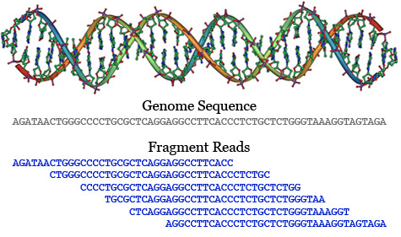
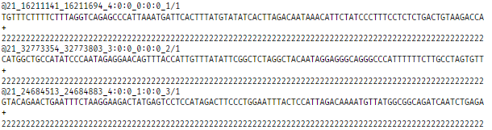
DNA and Sequencing Background
Read alignment locates the position of a read in a reference genome.
A read is a sequence of DNA.
Read alignment is the common first step during genomic data analysis and can be the bottleneck stage.
Next generation sequencing techniques have created a massive volume of genomic data.
Figure 1 Genome Sequence and Reads
Figure 2 Sample reads file
Notes:
A read is a sequence of nucleotides obtained from an individual sequencing experiment.
Short read alignment involves mapping a short “read” against a reference genome to locate where in the genome the sequence of reads is from. This is to discover the variation of a newly sequenced genome with respect to the previously sequenced human genomes. These previously sequenced genomes act as a reference genome. When a new genome is sequenced, the genetic material is broken into short overlapping fragments. Once sequenced, the readings of these individual fragments need to be put back together in order to be analysed and this is done using a reference genome
This is a hard problem
In the process we need to Locate a read of 100 characters in a genome sequence of 3.6 billion characters. BWT compression algorithm makes it slightly easier. alignment is a common first step during genomic data analysis and plays a critical role in medical and population genetics.
Although next-generation sequencing technologies have provided a vast amount of data samples for advancing genomic research, the ever-increasing volume of genomic data has become a tremendous challenge on multiple fronts. One such challenge is read alignment.
A reference genome is the standard sequence of genes for an organism in which newly sequenced genomes can be compared.

Slide 4
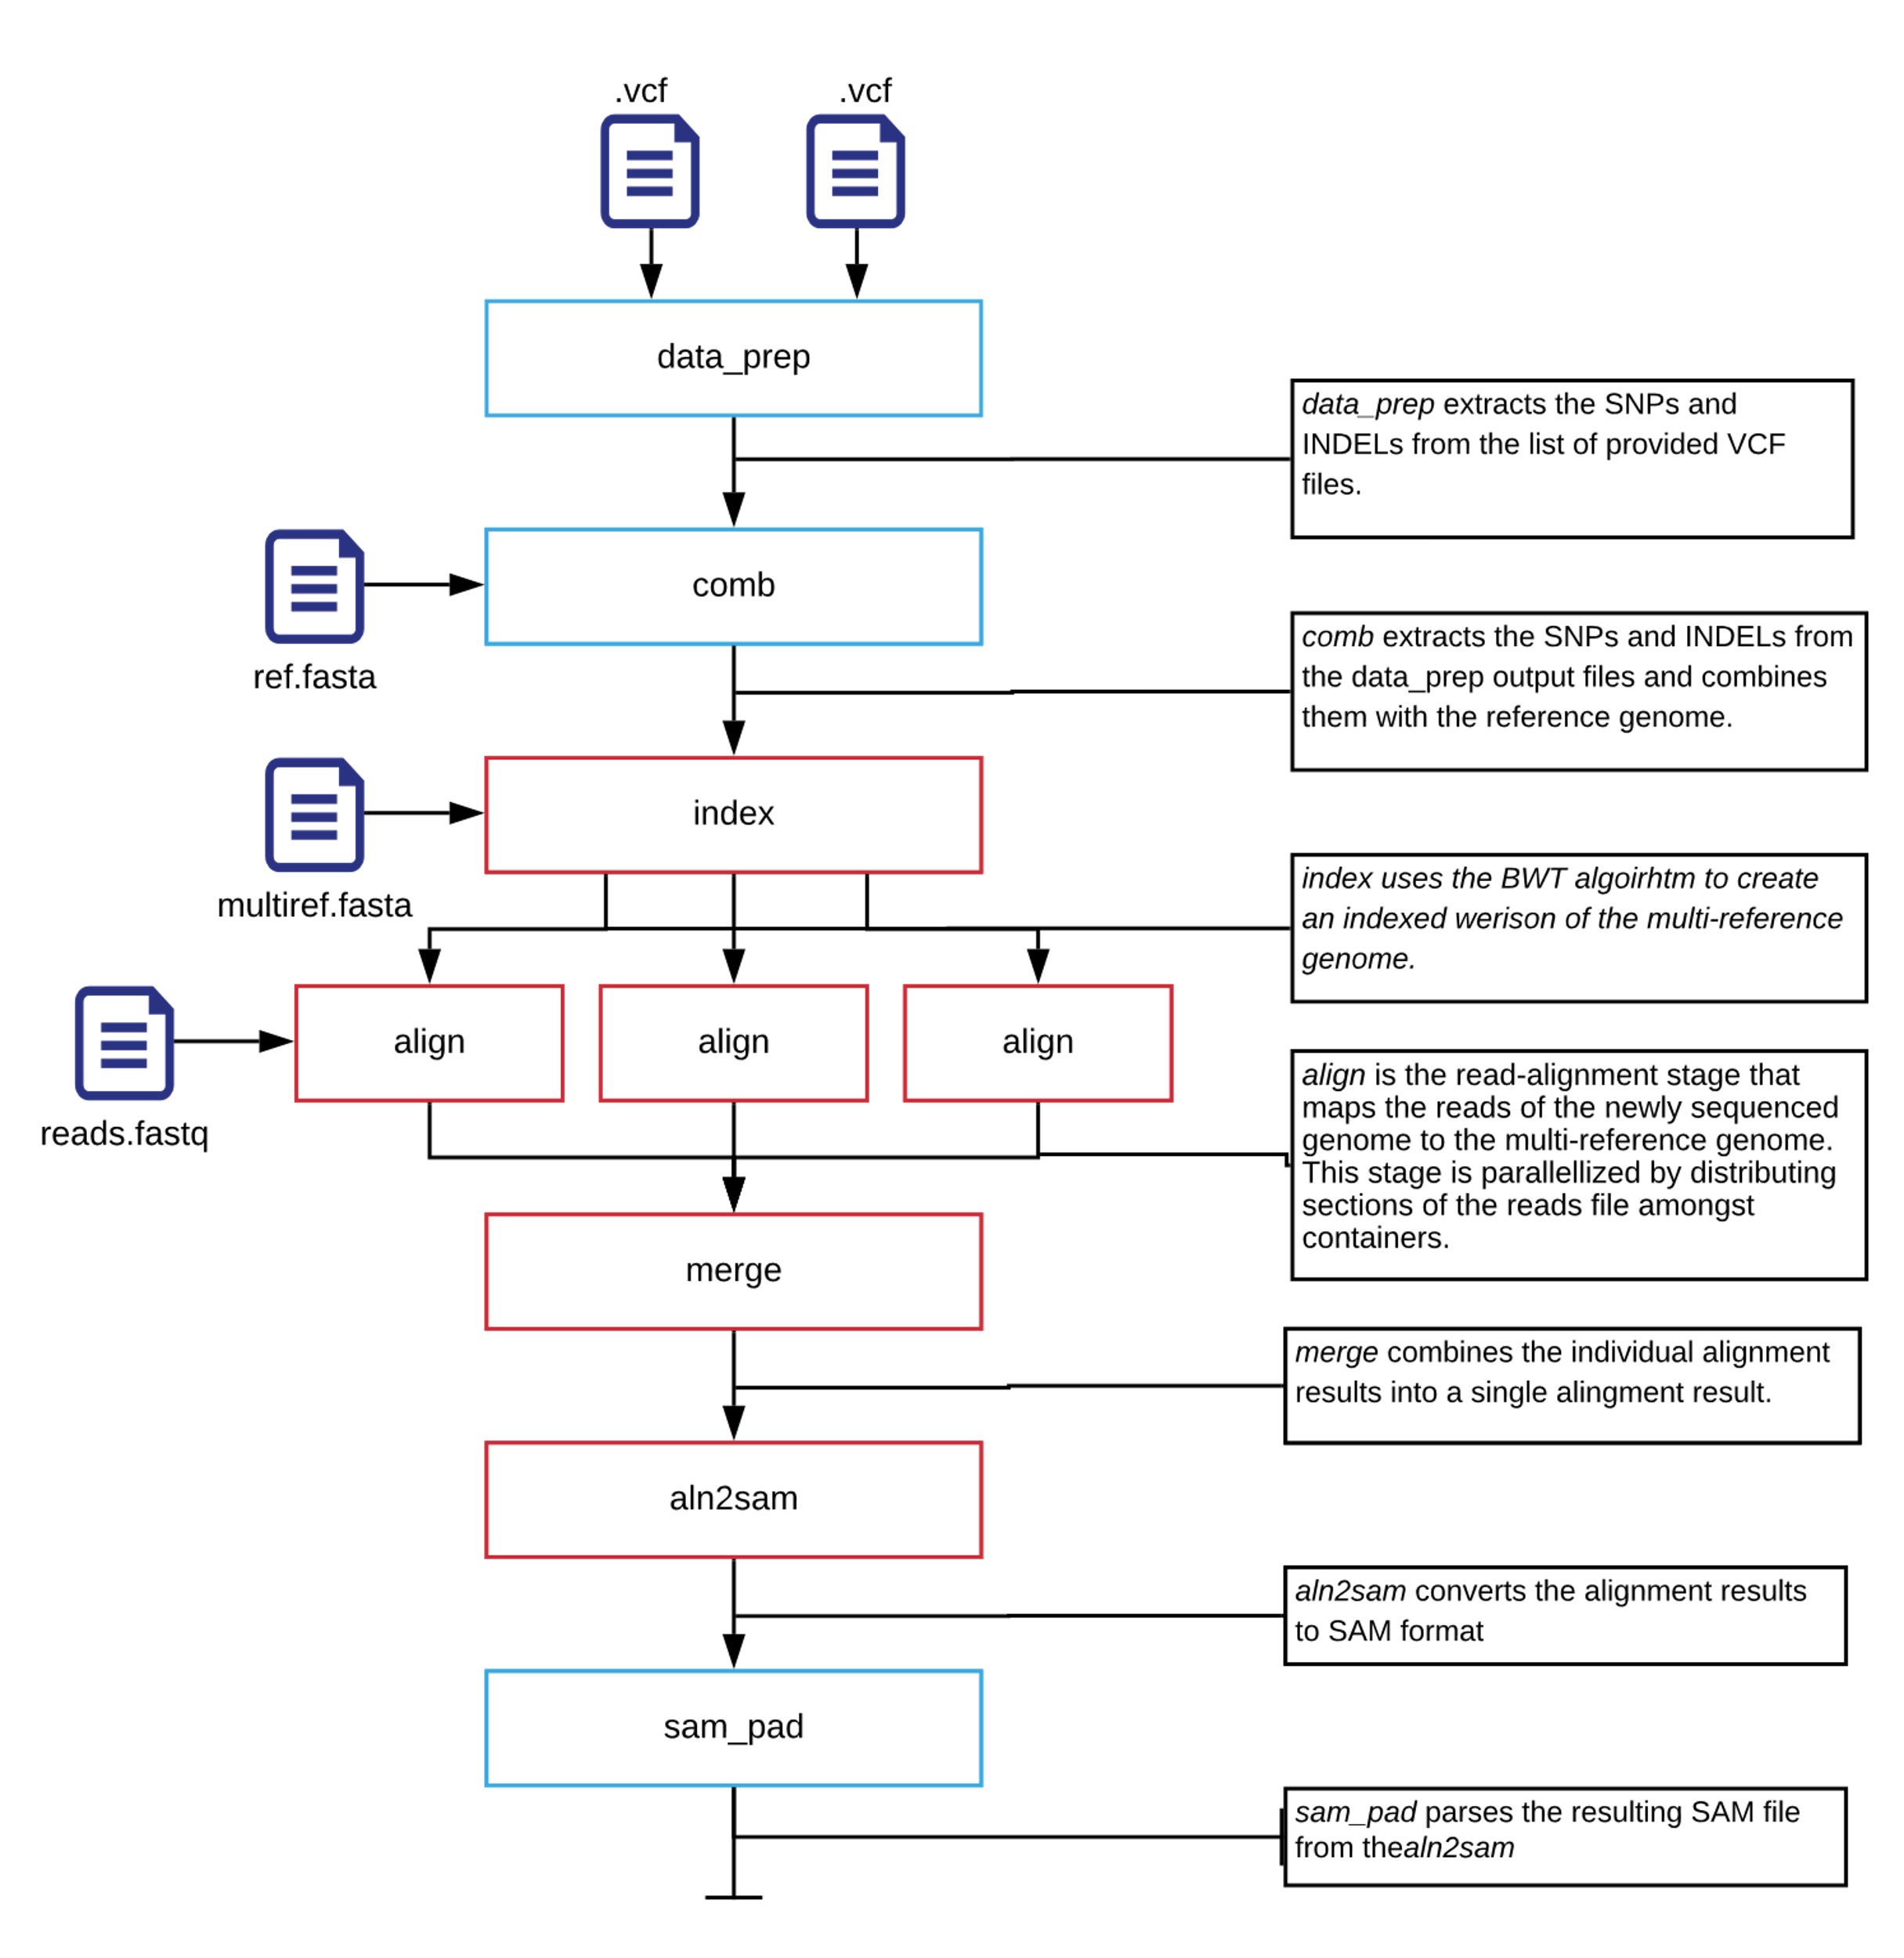
Problem Statement
BWBBLE is a read alignment program that uses a multi-reference genome.
It is 100 times slower than other read alignment programs (Huang, Popic, & Batzoglou, 2013).
Existing cloud-based BWBBLE aligners introduce significant cost and infrastructure management overheads – limiting adoption and accessibility.
Figure 3 BWBBLE Stages
Notes:
BWBBLE is a read alignment program that uses a multi-reference genome. This multi-reference genome is an arbitrary collection of two or more (up to millions of) genomes. It does this with high accuracy and no inherent bias to one specific genome.
Current read aligners that use a single reference genome are simply not deigned to handle sequencing of organisms with high large amount of genomic variation among individuals which lead to poor alignment accuracy. (Sea squirt is a n example here, polymorphism rate of ~4.5%. With such a high plymoriphism rate. The genome of this any newly sequenced individual of this species will be very different form a single convential reference genome.
So its great that BWBBLE uses a multi-reference genome buttt… Due to larger amount of data BWBBLE processes when mapping the reads against multiple reference genomes instead of just one, it is up to 100 times slower than other read alignment programs.
To minimize the time taken to perform short-read alignments with BWBBLE, various parallelized execution models such as AWS-BWBBLE (McGinley, 2019) and SparkBWBBLE (Stratford, 2018) have been developed. While they succeed in demonstrating the potential for a linear speedup by distributed reads amongst several cloudbased virtual machines, they introduce significant cost and infrastructure management overhead. As a result of this overhead, adoption has been limited and the practical speedups achieved remain out of reach of DNA researchers.
To shed light on some of the technical overheads demanded of AWS-BWBBLE a user had to launch an EC2 instance, get instance details, do a stsus check to make syre it was ready to receive commands and healthy.
Mount EFS.
Run docker container with bind mounts. Split the reads.

Slide 5
Project Objective
Reduce the time taken by geneticists to perform a BWBBLE read alignment.
Remove the technical and infrastructure management overhead associated with existing cloud-based BWBBLE aligners.
Notes:
This project aims to reduce the time taken for geneticists to perform a BWBBLE alignment job using modern job orchestration tools such as Kubernetes.
We want to remove the technical and infrastructure management overhead associated with existing cloud-based aligners to enable any researcher to gain the benefit on a limited budget.

Slide 6
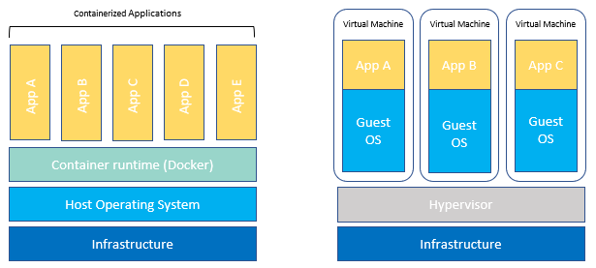
Project Design Overview
The project runs BWBBLE as a container.
A container bundles software up with the dependencies and libraries it needs to run in different environments.
Containers are like VMs but are an OS-level virtualization – they are lightweight and operate at scale with better resource utilization.
Figure 4 Container OS-level vs VM hardware-level virtualization
Notes:
Containers are like VMs but are an OS-level virtualization wit multiple containers running on the OS kernel – making them incredibly lightweight.
They have better resource utilization and scalability than VMS with the same workload.
Containers can be thought of an atomic unit of deployment and reuse.
They package up the software with all its dependencies, enabling the same application to run reliably and quickly in different development environments. This makes containers attractive for use in scientific workloads as it can be challenging to achieve consistent results when reproducing scientific research in different cloud environments due to the dependencies included in scientific workloads and changing computer environments (Boettiger, 2014).

Slide 7
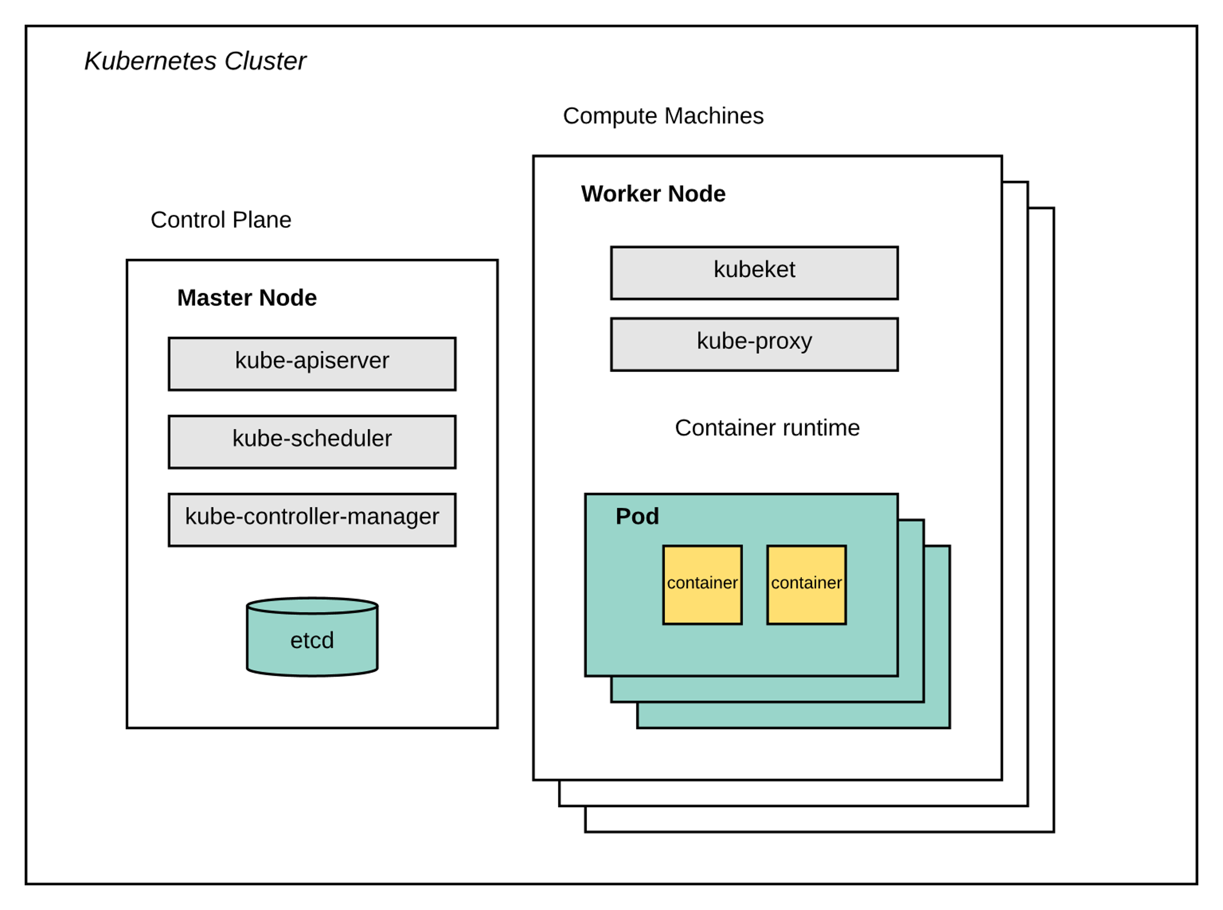
Kubernetes
Kubernetes manages the scheduling and orchestration of containers.
Kubernetes runs containers in a Pod.
A Pod runs on a Node.
To communicate with Pods on our cluster we use the Kubernetes API.
This project uses Azure Kubernetes Service to run our Kubernetes cluster.
Figure 4 Kubernetes Architecture
Notes:
Kubernetes is used explicitly as opposed to virtual machines or plain Docker because of its user accessibility, its API extension benefits and because it is currently the industry standard for architecting, managing, and deploying cloud native applications.
Running BWBBLE on Kubernetes abstracts the minutiae of running the BWBBLE application and managing VMs away from the user which makes running a BWBBLE read alignment much more accessible – both in terms of cost and technical skill.
This project uses Azure Kubernetes Service to reduce the operational burden of deploying and managing the different components needed to run a Kubernetes cluster. It manages the Kubernetes control plane components

Slide 8
Design Overview
Run BWBBLE in a container using Docker.
Run BWBBLE on Kubernetes.
Run BWBBLE on Azure – AKS, Azure Storage and ACIs.
Develop an AlignJob “CRD” to represent a full alignment.
Develop a Controller to handle the AlignJob.

Slide 9
BWBBLE Stages
data_prep
comb
index
align*
aln2sam
sam_pad
* the align stage is parallelizable
Notes:
Data prep phases depend only on reference genome
Alignment phases depend on the reads file
These can be split up and executed separately (cache the genome for repeated use)

Slide 10
Running in Kubernetes
Each BWBBLE stage is executed as Kubernetes Job
Each “Job” runs on a Kubernetes Pod.
Kubernetes doesn’t support Job dependencies natively
We need to implement this ourselves
The Kubernetes API can be extended with CRDs
We defined our own AlignJob type to describe a full BWBBLE alignment
Input reads file
Input genome file
Parallelism

Slide 11
Using Azure
Using Azure Kubernetes Service
Fully managed (simpler to setup and keep updated)
Supports scaling onto Azure Container Instances
Using Azure File Shares (Azure Storage Accounts)
Low cost, high performance
Can be mounted into Kubernetes Pods
Supports multiple concurrent reader/writers
Integrated with Azure Active Directory for authentication
Supports 2FA and RBAC
Notes:
Azure Container Instances (ACIs) allow us to take advantage of per-second billing and a massive degree of burst scalability to run more complex workflows
It was important for us to look at the security of our cluster running the read alignment as through my research, I learned that significant effort has been made in increasing the performance of read-aligners. Few have looked at privacy preserving read –alignment and securely deploying their solution to the cloud. This is alarming to me as genomes are privacy sensitive, since they store personal information about their donors, such as their identity, disease risks, heredity and ethnic origin. MaskAl is a brilliant paper that details how it uses masked reads using Intel SGX to preserve privacy and how at the red alignment stage genomic data can be observable by an adversary.

Slide 12
Parallelizing BWBBLE
Reads file sequences can be distributed to many workers
No dependencies within a reads file (embarrassingly parallel)
No required ordering
Extended BWBBLE to support reading a range from the reads file
Calculated ranges by slicing the file into several sections (parallelism)
Ran one Kubernetes Job per reads file section
Merge resulting outputs using “cat”
Ran this in a Kubernetes Job after all align jobs had completed
Used Azure Container Instances to run align jobs
Per-second billing for extra compute capacity

Slide 13
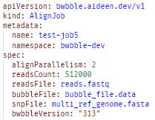
Extending Kubernetes
Kubernetes Custom Resource Definition (CRD)
Tells Kubernetes about our AlignJob
It will store the job for us
It can validate requests for correctness
Lets us use the standard Kubernetes client
Figure 5 AlignJob CRD

Slide 14
Extending Kubernetes
Used Python Kubernetes Client to implement a Controller
Monitor the creation of AlignJobs (our CRD) and create Jobs to do work
Monitor Jobs to determine when to proceed to the next stage
Uses the Kubernetes “Watcher” to get notified of changes
Relies on state stored in the AlignJob resource

Slide 15
AlignJob Stages
start
align
merge
aln2sam
sampad
cleanup
complete
align
align
complete

Slide 16
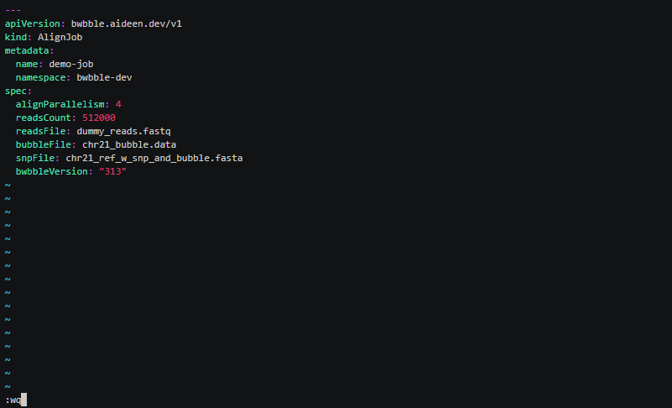
Running an AlignJob

Slide 17
AlignJob Stages
start
align
merge
aln2sam
sampad
cleanup
complete
align
align
complete

Slide 18
Results

Slide 19
Alignment Stage Speed-up
91% average speedup factor
Alignment time is composed of fixed and variable costs
Fixed costs include application start-up, reading the reference genome
Variable costs increase linearly with the size of the input
Notes:
This chart plots the linear speedup, K8s-BWBBLE Align Time speedup and practical speedup against the level of parallelism. K8s-BWBBLE align time refers to the time to execute the BWBBLE align code, not including the time taken to start and schedule it’s Pod. The practical speedup is the end-end time for completing an AlignJob using K8s-BWBBLE, from submitting the AlignJob to deleting all the resources used.
The average speedup factor of K8s-BWBBLE is 91%. This means by adding an extra container we will reduce the align stage time by 91%.
The practical speedup does not reduce relative to the level of parallelism. The practical speedup is limited by the time we spend in other stages of BWBBLE and the AKS overhead. Although the align stage is the longest individual BWBBLE stage, the other stages combined make up most of our experienced end-end run time. With a larger reads file, it is expected that the practical speedup will reduce more noticeable relative to the level of parallelism applied.

Slide 20
Practical Speed-up
Align accounts for 36% of runtime when parallelization is used
Other stages account for most of the time taken.

Slide 21
Practical Speed-up

Slide 22
Scaling for High Parallelism
Notes:
This chart shows the theoretical execution times for running a reads file of 25,600,000 reads with different levels of parallelism. The chart is an estimation of our performance scalability and is based on a modelling equation.
Initially we get a large return on investment relative to the level of parallelism applied.
We can reduce the time to complete and alignment from 01:32:43 to 00:15:56 by adding 6 Pods. However, to get below 10 minutes we need to add and additional 4 Pods. As we seek lower runtimes, we experience diminishing returns on adding additional compute resources.
Even if we reduce the AKS overhead for the align stage to 3 seconds, the total runtime of the program is still 7 minutes and 39 seconds.
Bottleneck is the other stages
At this point we are IO constrained. For the greatest return on investment, the best place to start speeding up BWBBLE is by re-architectuing the C source code itself. BWBBLE is not built to be mutli-threaded and highly parallelizable. We could introduce pipelining and asynchronous IO into the other stages to reduce the use of malloc and the number of times we unnecessarily read and write data to memory.

Slide 23
Potential Improvements
Container start-up time
Reduce the container image size by using a smaller base image
Schedule containers onto dedicated hardware (increases costs significantly)
Re-use application instances (rewrite BWBBLE to be a job runner)
Use a scheduler with shorter placement time (Nomad etc)
Combine multiple stages into a single pod (schedule once)
Throughput
Use faster I/O (NVMe) if using dedicated infrastructure
Use a pipeline architecture to reduce memory usage
Use async I/O to prevent blocking while performing work
Notes:
Container image that creates the executable container is made up of layers. The larger the image the more layers need to be downloaded over the network. Ubuntu 155MB -5 MB. Make difference as for each Pod. I.e BWBBLE stage executed we need to download this container image.
This is still reducing a small portion of the time. We need to rearchitect BWBBLE and parallellize the aln3sam and sampad phase,
Nomad (optimistically concurrent distributed scheduler – much faster than K8s) - https://www.hashicorp.com/c1m

Slide 24
Conclusion
Kubernetes
Kubernetes API simplifies user interaction and security
Simplified running highly parallelized jobs
Very low running cost (when compared to alternatives)
It adds performance penalties and overheads
It is complex to integrate with
Value of parallelization increases with the size of your dataset
Other BWBBLE stages need to be parallelized and optimized to further reduce practical runtimes
Notes:
Performance Penalties
Scheduling time
Container start-up time
Networked storage

Slide 25
Thank you
Notes:
Performance Penalties
Scheduling time
Container start-up time
Networked storage

